Slide 1
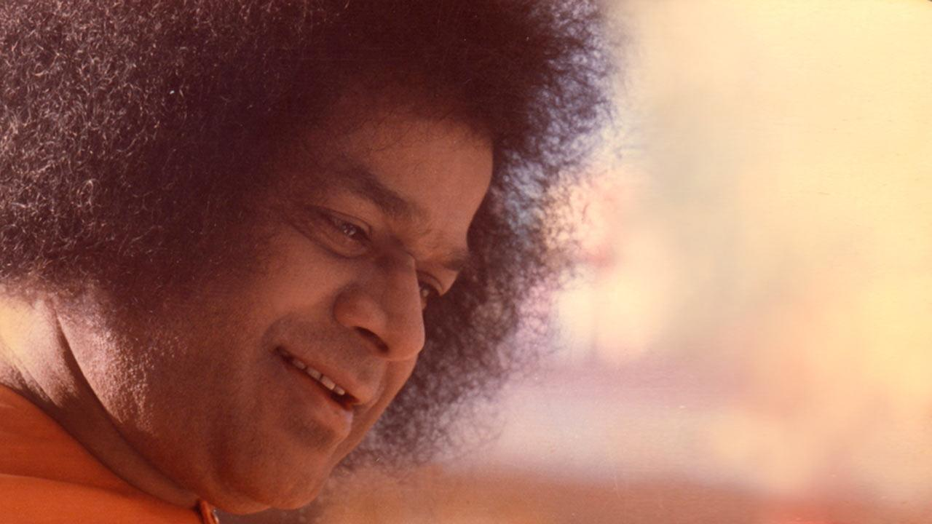
An Offering at His Lotus Feet

Slide 2

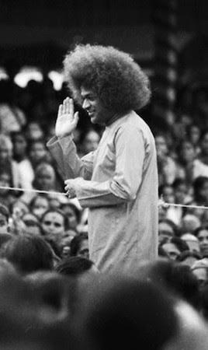
A Presentation for Project
in
Masters in Technology in Computer Science
2022- 24

Slide 3
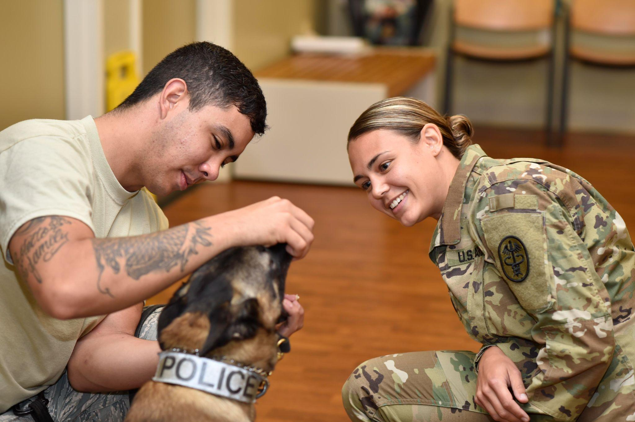
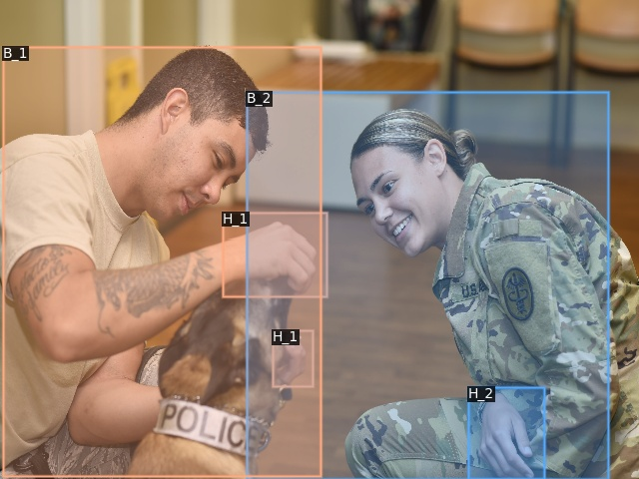
Hand and Associated Body Localization
Guided By-
Dr. S Balasubramanian
A Presentation by:
Bikash Ranjan Padhy
Regd. No:22554

Slide 4
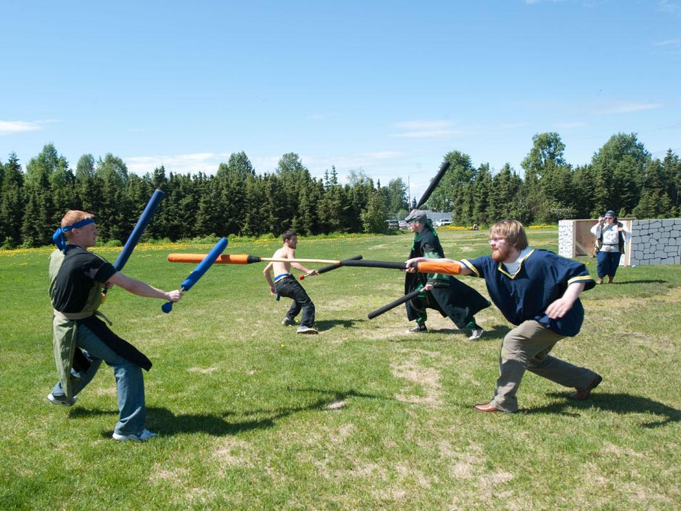
Problem Statement
Detecting hands and finding the location of the corresponding person for each detected hand
challenges in unconstrained conditions
multiple people in the scene
varying overlaps
occlusions

Slide 5
Introduction
Why Hand-body localization?
Security and Surveillance: detecting the culprit in a crowded area
Social AR: tracking of hands and bodies is essential for collaboration, interaction and communication in the same augmented environment
Healthcare and Telemedicine: track the movements of patients for monitoring their health and remote medical assistance
Sign language: (human-human communication) interpretation- who said what

Slide 6
Dataset
unconstrained high quality images - annotations for hand locations and their corresponding body locations
20,490(including 1,629 test) images with bounding box annotations - more than 57K hand and 63K body instances
varying degrees of occlusions and overlap - challenging
annotation: an xml file for each image
for each object annotation-file has-
name(body/ hand)
id(1,2,3…)
bounding box coordinates(xmin, ymin, xmax, ymax)
segmentation coordinates(x1, x2, x3, x4, y1, y2, y3, y4)
association of body and hand - name & body id together

Slide 7
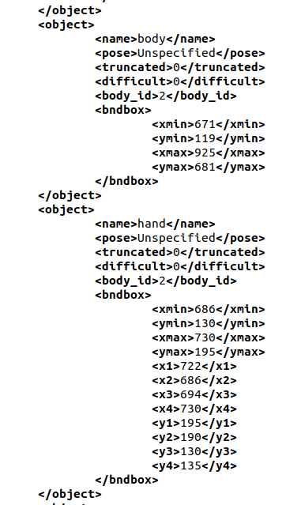

Dataset
+

Slide 8
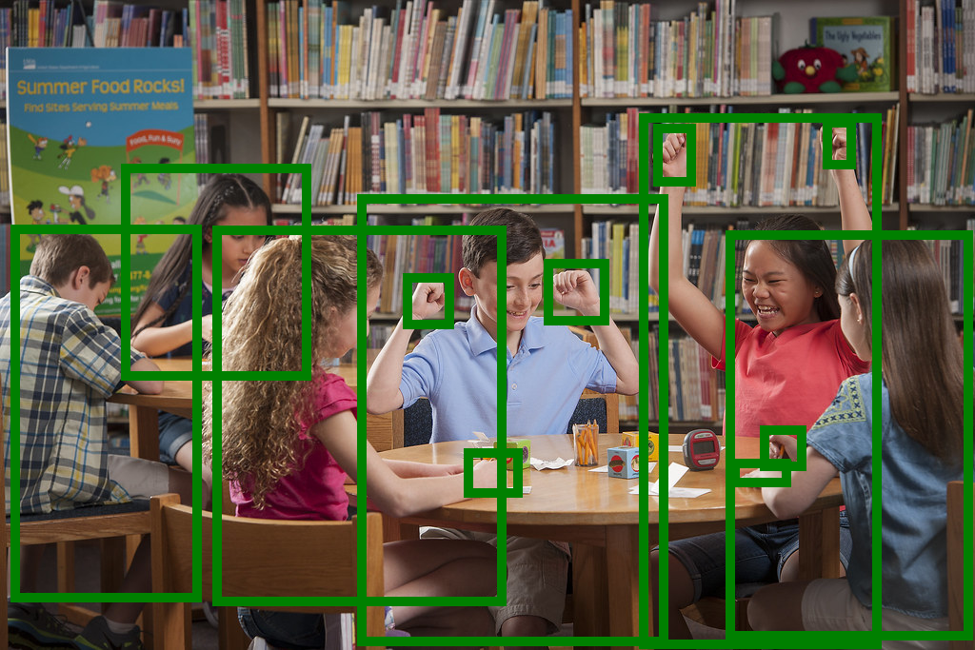
Datapoint Visualisation

Slide 9
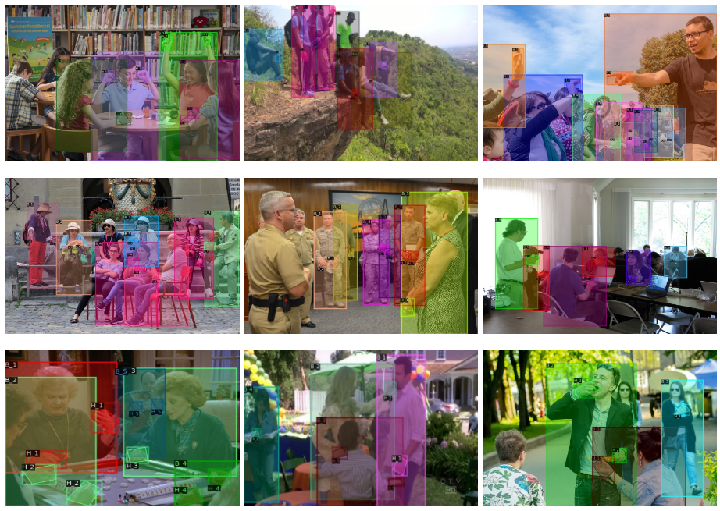
Dataset
Link to the dataset

Slide 10
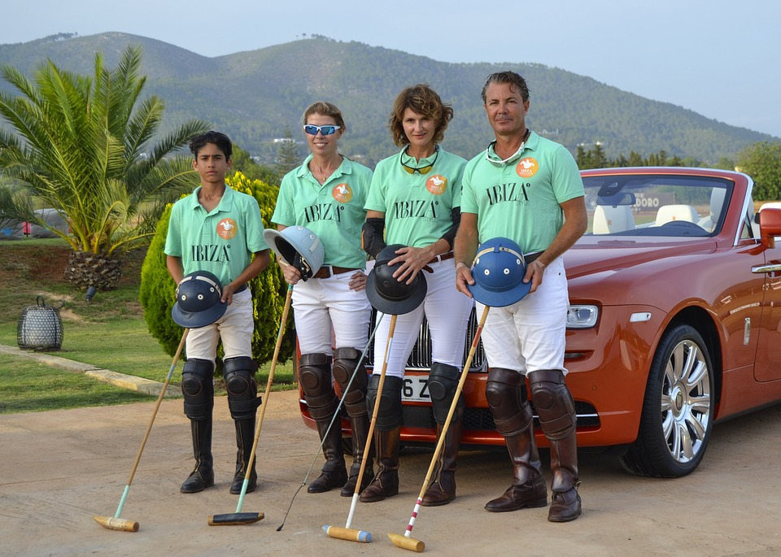
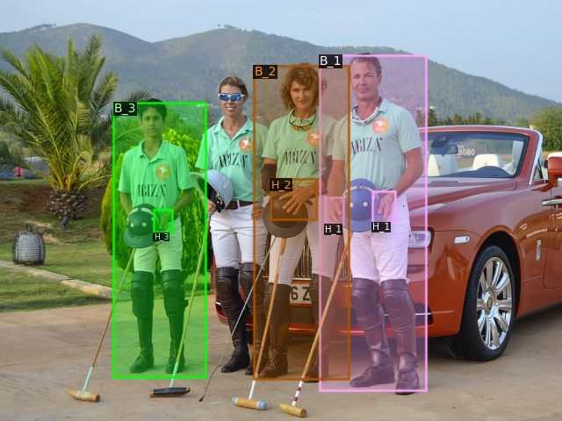
Model Framework
Box
class, Regress
Backbone + FPN
RPN
ROI Align
Association
Mask

Slide 11
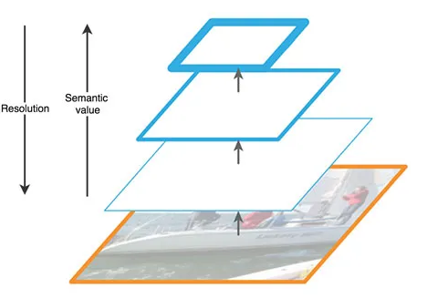
Feature Pyramid Network
a feature extractor
multi-scale feature maps
feature fusion- marginal extra cost
better semantics + higher resolution ft.maps

Slide 12
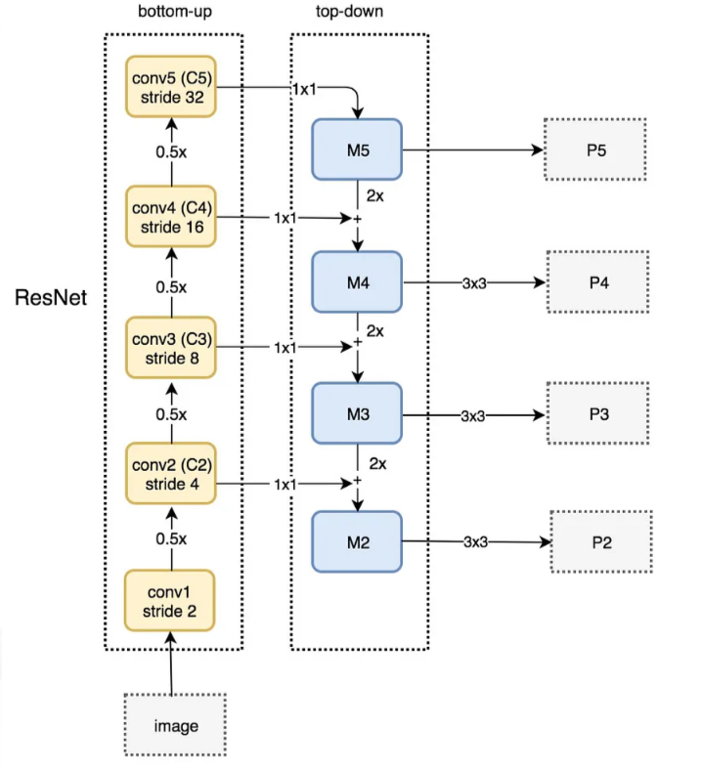
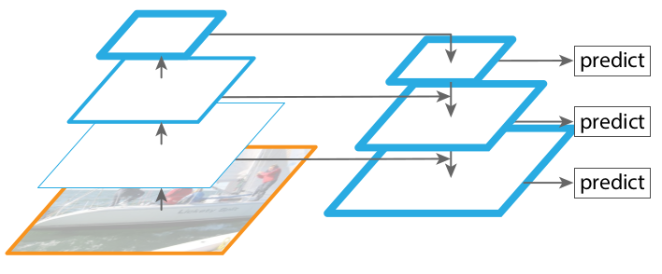
Feature Pyramid Network
Backbone = ResNet50

Slide 13
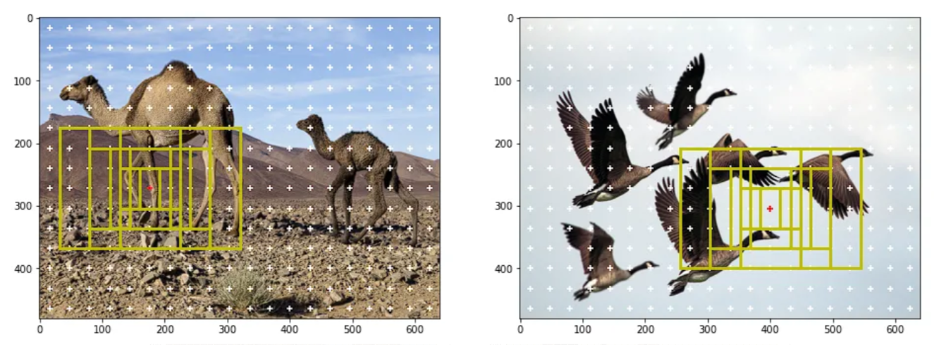
Region Proposal Network
Anchor boxes - various sizes and aspect ratios in the image grid (for visualisation)

Slide 14
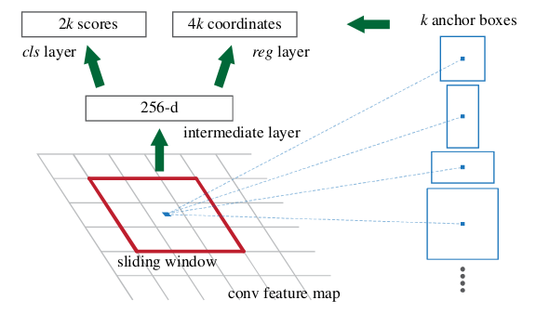
Region Proposal Network
Anchor Boxes: of different scales and aspect ratios - at different spatial locations across the feature map grid
Predicts two key properties - each anchor box: objectness score and bounding box regression deltas; 2 separate convolutional layers
Objectness Score: using a convolutional layer - the likelihood of an anchor containing an object

Slide 15
Region Proposal Network
Bounding Box Regression Deltas: Another convolutional layer predicts - each anchor - changes in the box's location, width, and height(dx1, dy1, dx2, dy2)
Non-Maximum Suppression (NMS): filter out redundant or overlapping anchors - based on their objectness scores
Positive & Negative: positive anchors(1) - contain objects; negative anchors(0) - background anchors
BB Regression Targets: calculated for positive anchors - ground-truth box it is matched with
Loss Computation: for predictions and targets; binary cross-entropy loss for objectness scores and a smooth L1 loss for bounding box regression

Slide 16
ROI Pooling
Input Features and Region Proposals:
2D feature maps from CNN backbone
Region proposals, generated by the Region Proposal Network (RPN)
Adaptive Pooling:
output size - fixed grid (e.g., 7x7 cells)
extract a single value from the corresponding region in the input feature map
Output Feature Map:
fixed-sized feature maps (e.g., 7x7) for each region proposal
flattened and passed through fully connected layers
perform object classification and bounding box regression

Slide 17
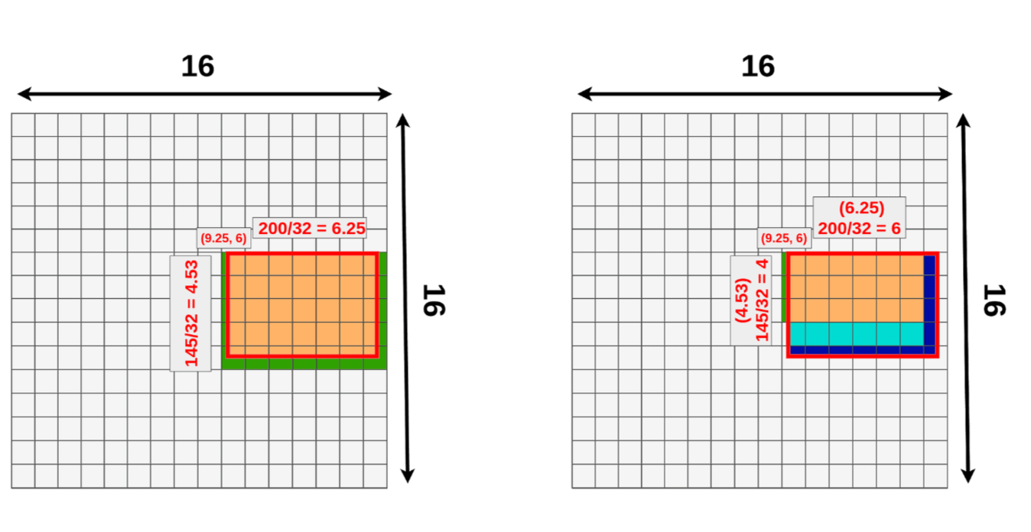
image input size - 512x512x3 | feature map size - 16x16x512 | scale factor is 32
Left: ROI Align Right: ROI Pooling

Slide 18
ROI Align
Sub-pixel Sampling:
❌ Instead of dividing the RoI into a grid and performing pooling,
✅ apply bilinear interpolation to the feature map; more accurate alignment with feature map
Precise Localization: capable of interpolating features from arbitrary spatial locations within the RoI -> more precise localization
Better Handling of Small RoIs: doesn't discard spatial information unlike RoI pooling

Slide 19
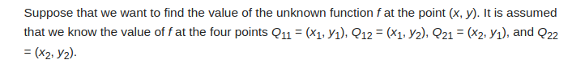
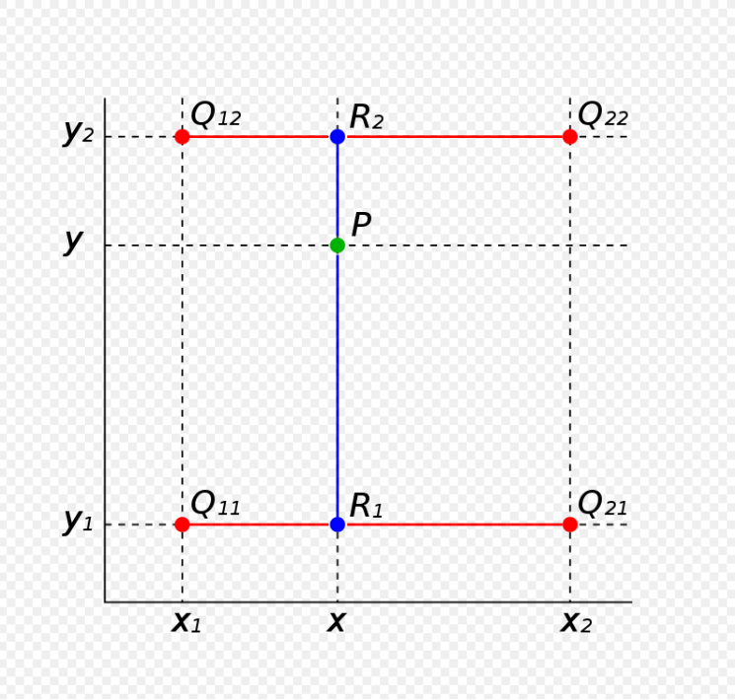
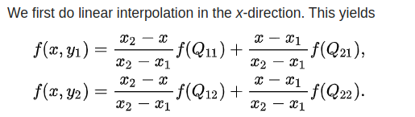
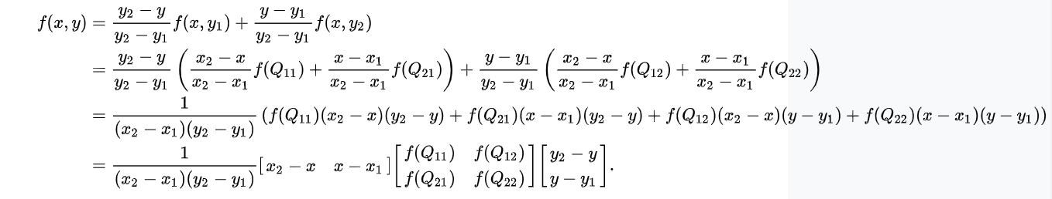
Bilinear Interpolation

Slide 20
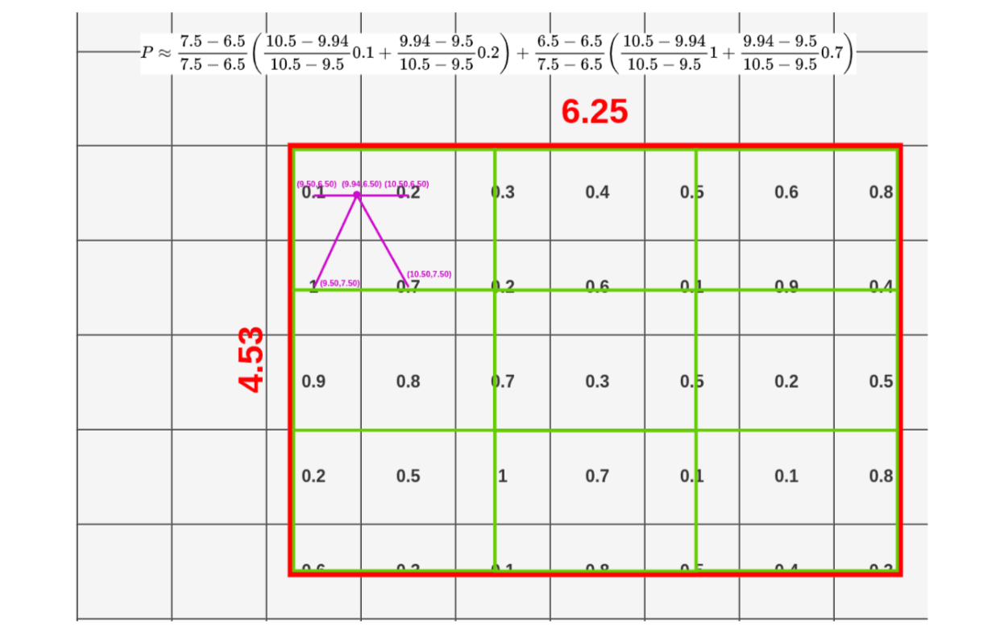
First dot(Out of 4 dots) value calculation in the first cell of the 3x3 output

Slide 21
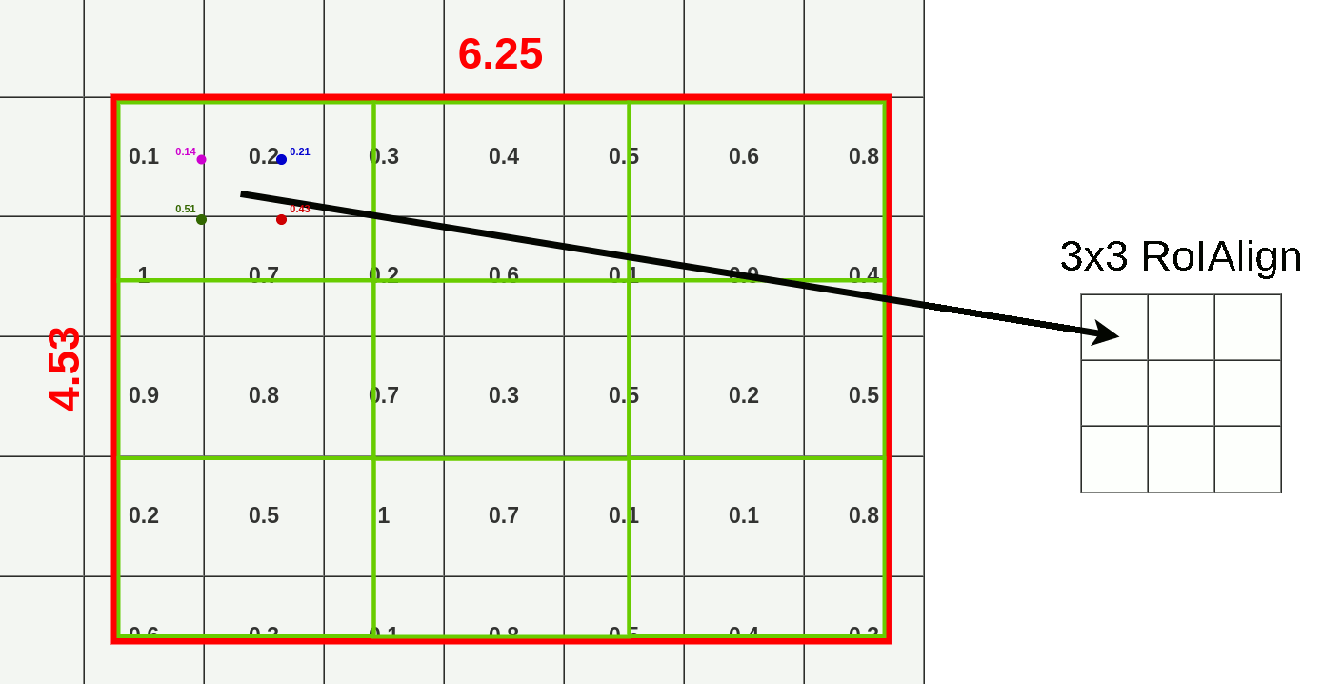

Slide 22
Association
Body Bboxes and Hand Bboxes overlap in dataset - Bbox covers the entire body- including the hand
During Testing, the Body Bbox covers the hand - Overlap
For each Hand Bbox, check overlap with all Body Bbox in the image - Bipartite Matching for areas

Slide 23
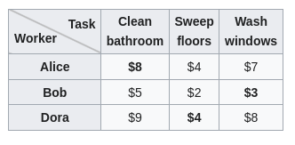
Association
Each body box is a candidate for a hand, and the hand box itself too - if there are no bodies but only hands in the image
Hungarian Algorithm
Notes:
Confidence score of positional density:
conf_hand_no=exp(−2.0×10−1×∑i​∣μhand_hand_no,i​−μbody_hand_no,i​∣)

Slide 24
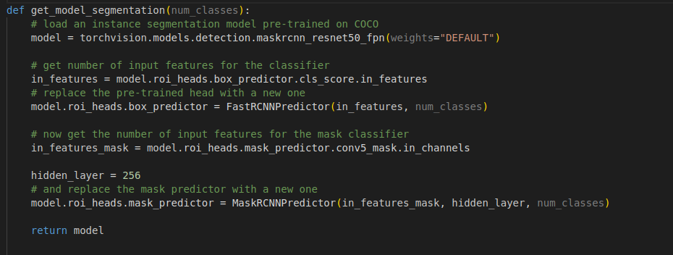
Code Snippet

Slide 25
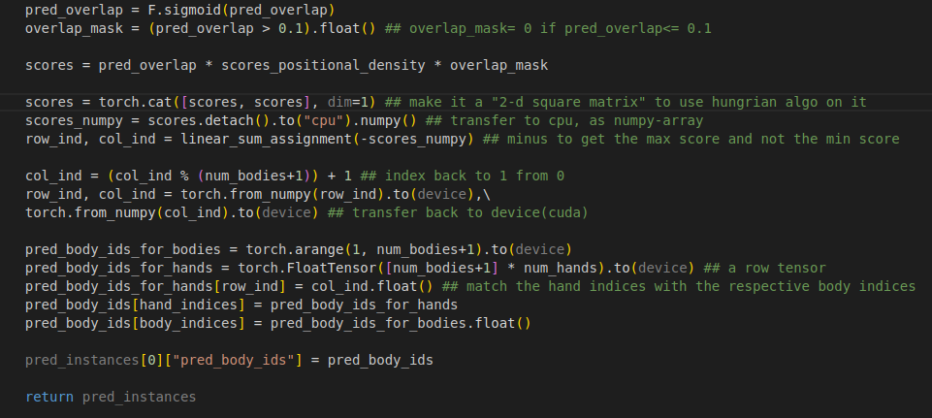
Code Snippet

Slide 26
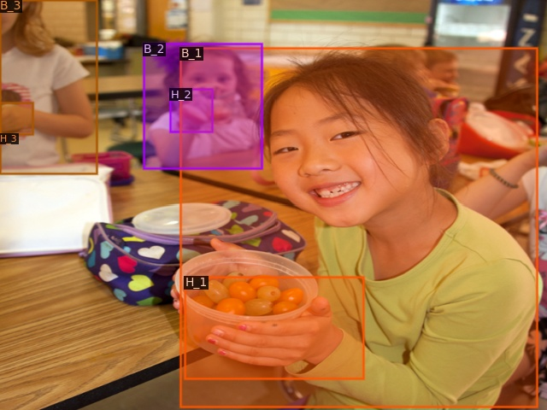
Results

Slide 27
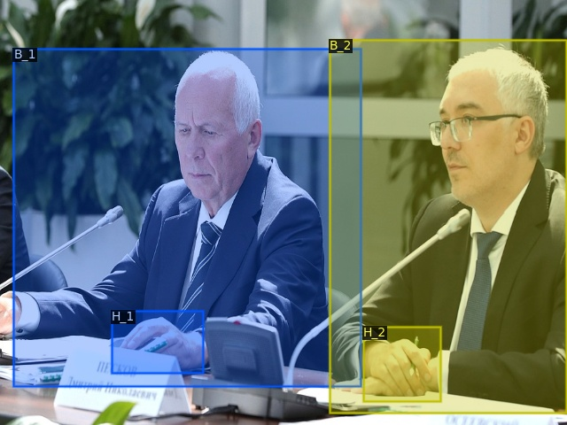
Results

Slide 28
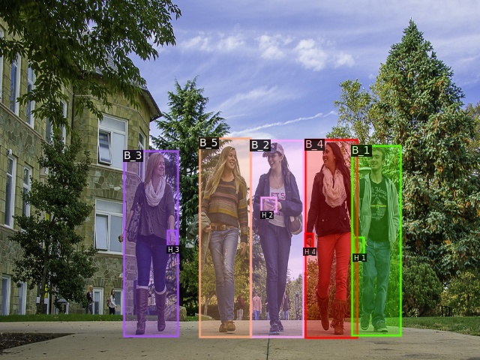
Results

Slide 29
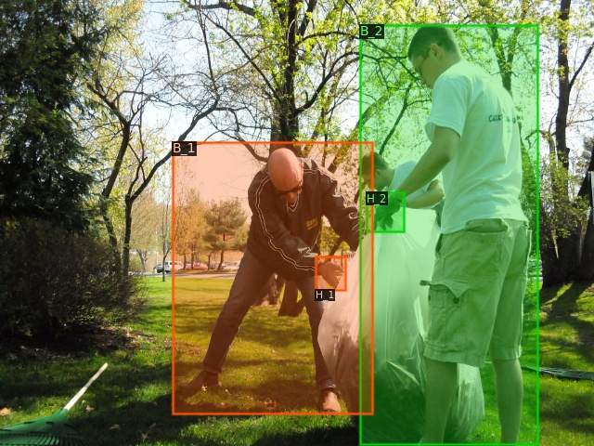
Results

Slide 30
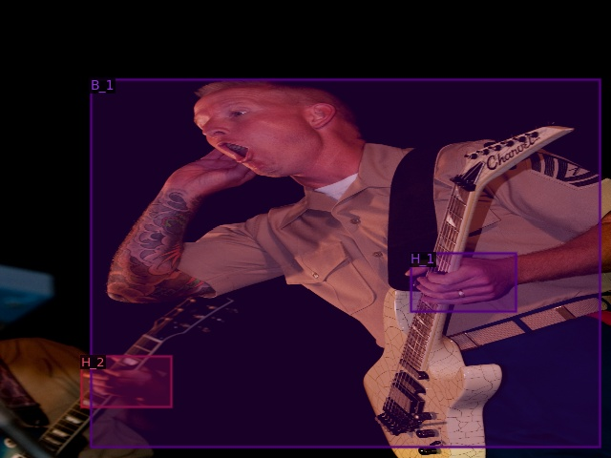
Results

Slide 31
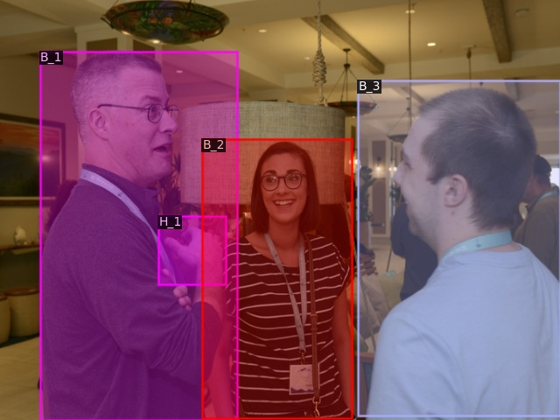
Results

Slide 32
Future Work
Making the association part learnable
Try other models- YOLO

Slide 33

Acknowledgements
Swami
Dr. S Balasubramanian
Parents
DMACS
Internet

Slide 34
References
Narasimhaswamy, T. Nguyen, M. Huang, M. Hoai. Whose Hands Are These Hand Detection and Hand-Body Association. In CVPR 2022.
Kaiming He, Georgia Gkioxari, Piotr Dollár, and Ross Girshick. Mask R-CNN. In Proceedings of the International Conference on Computer Vision, 2017.
R. Girshick, J. Donahue, T. Darrell, and J. Malik. Rich feature hierarchies for accurate object detection and semantic segmentation. In CVPR, 2014.
S. Ren, K. He, R. Girshick, and J. Sun. Faster R-CNN: Towards real-time object detection with region proposal net- works. In NIPS, 2015.
T.-Y. Lin, P. Dollár, R. Girshick, K. He, B. Hariharan, and S. Belongie. Feature pyramid networks for object detection. In CVPR, 2017.
R. Girshick. Fast R-CNN. In ICCV, 2015.
Facebook Research - Detectron2

Slide 35

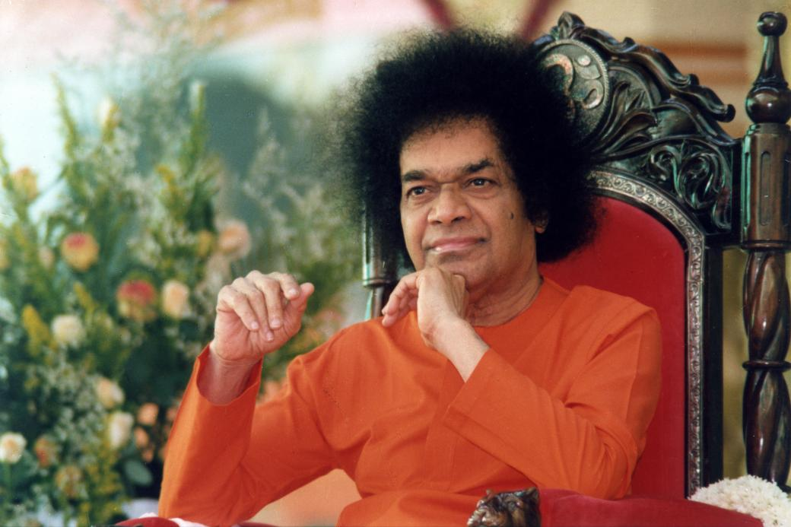
Sairam, thank You

Slide 36
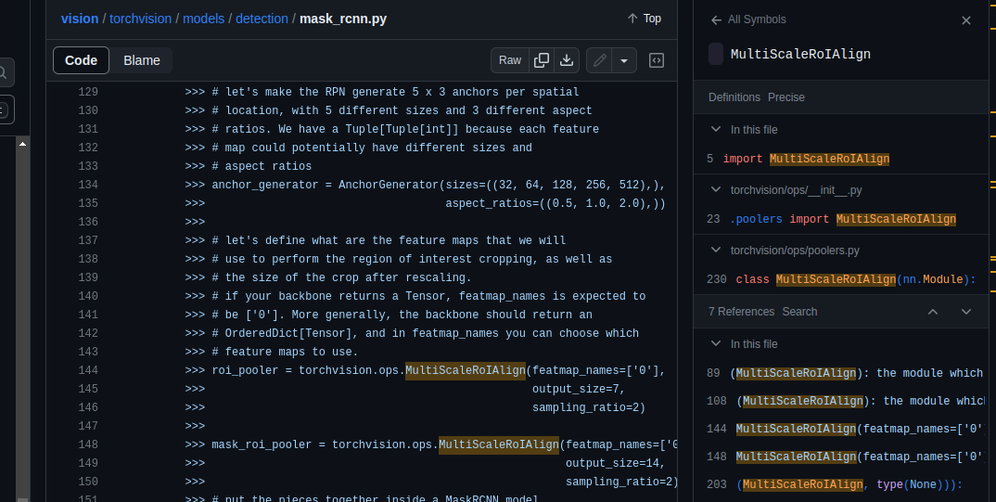
Pytorch’s mask_rcnn model uses MultiScaleRoIAlign for box and mask

Slide 37
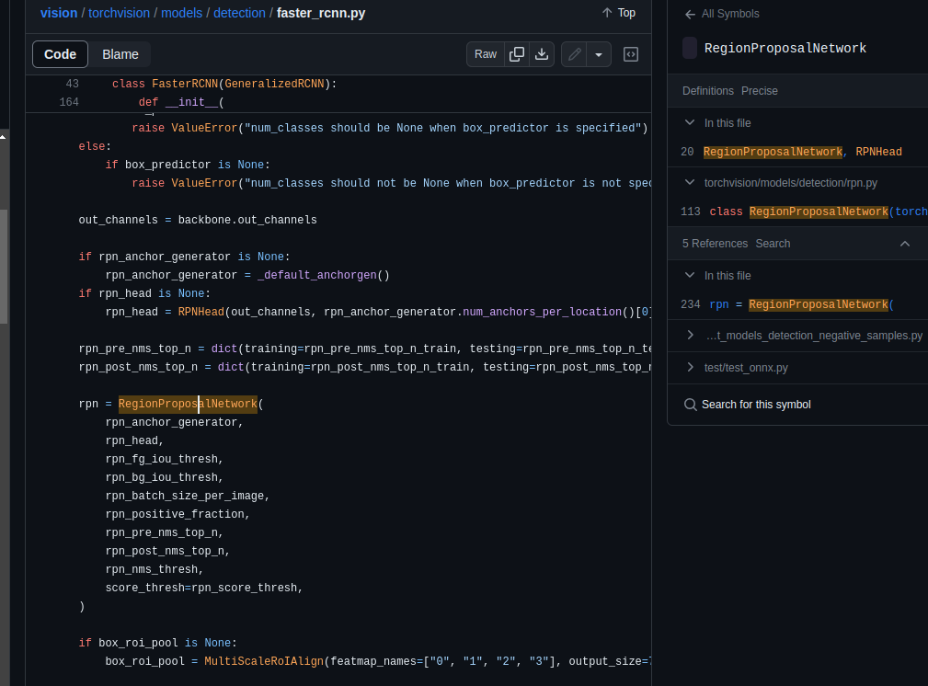
RegionProposalNetwork

